Slide 1
Resiliency and Recovery in the cloud
© 2021, Amazon Web Services, Inc. or its Affiliates. All rights reserved. Amazon Confidential
Notes:
[PROVIDE YOUR OWN INTRODUCTION]

Slide 2
Managing failure
“Everything fails, all the time.”
– Werner Vogels, Amazon CTO
“We needed to build systems that embrace failure as a natural occurrence.”
Shared responsibility model
AWS: Reliability of the Cloud
Customer: Reliability in the Cloud
Notes:
“We” → Shared responsibility
AWS: AWS Components abstract away low level failures like hard-drives and power supplies
AWS: AWS services are built using Best Practices like redundancy to ensure availability
Customer: Use tools AWS offers so their workloads follow best practices. Self architected using zones and regions.
Disks, CPUs, power supplies – AWS abstracts these away
Bigger issues can sometimes bubble up – AWS services help mitigate these
Failure prevention is good, but failure management handles the failures that occur despite such prevention

Slide 3
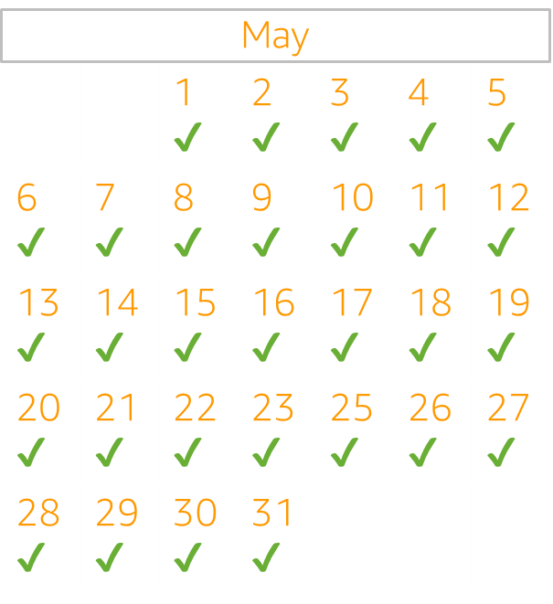
High availability (HA)
About application availability
Smaller scale, more frequent events:
Component failures
Network issues
Load spikes
Measures mean over time:
“The 9’s” (99.99% available)
Notes:
Availability focuses on more common disruptions of smaller scale such as component failures, network issues, and load spikes. Focused on preventing loss of service, generally measure by the time and application is able to fulfill its business function
You should first ensure your workload meets your availability objectives, as a highly available architecture will enable you to meet customers’ needs in the event of availability impacting events.
More important to understand them as points on a spectrum
The key difference is preventing loss of service and recovering from loss of service.
An example of this is: Consider a storage solution that continuously replicates to another site to achieve high availability. If a file or files are deleted or corrupted on the primary storage device, those destructive changes can be replicated to the secondary storage device. In this scenario, despite high availability, the ability to failover in case of data deletion or corruption will be compromised. Instead, a point-in-time backup is also required as part of a DR strategy.
Let’s highlight the difference between HA and DR by walking through this example.
This is an example of a simple 3-tier architecture, making use of three availability zones
The ELB is a Managed Service
EC2 instances are in all 3 AZs
RDS you simply tell it to be multi-AZ
S3 and DynamoDB: These services automatically replicate data and compute across multiple Azs – regional (versus zonal)

Slide 4
Disaster Recovery options in AWS
Warm standby in AWS
Hot standby
(with multi-site)
Backup & Restore
Pilot light
Low
High
RPO/RTO: Hours
RPO/RTO: Tens of Minutes
RPO/RTO: Minutes
RPO/RTO: Real-time
Test/Dev Environments
Solutions: AWS Backup, Amazon S3, AWS Storage Gateway
Cost: $
Production workloads
Scale AWS resources in response to a DR event
Cost: $$
Business critical workloads
Core services
Cost: $$$
Mission critical workloads
Active/Active modes using at least two AWS regions
Cost: $$$$
Notes:
Disaster recovery strategies available to you within AWS can be broadly categorized into four approaches, ranging from the low cost and low complexity of making backups to more complex strategies using Regions. It is critical to regularly test your disaster recovery strategy so that you have confidence in invoking it, should it become necessary
For a disaster event based on disruption or loss of one physical data center for a well-architected, highly available workload, you may only require a backup and restore approach to disaster recovery. If your definition of a disaster goes beyond the disruption or loss of a physical data center to that of a Region or if you are subject to regulatory requirements that require it, then you should consider Pilot Light, Warm Standby, or Hot Standby

Slide 5
Disaster Recovery options in AWS
Warm standby in AWS
Hot standby
(with multi-site)
Backup & Restore
Pilot light
Low
High
RPO/RTO: Hours
RPO/RTO: Tens of Minutes
RPO/RTO: Minutes
RPO/RTO: Real-time
Test/Dev Environments
Solutions: Amazon S3, AWS Storage Gateway
Cost: $
Production workloads
Scale AWS resources in response to a DR event
Cost: $$
Business critical workloads
Core services
Cost: $$$
Mission critical workloads
Active/Active modes using at least two AWS regions
Cost: $$$$

Slide 6


Hot Standby
Full replication of your environment running and ready for a failover during a disaster – it runs ‘hot’.
Active/passive strategy that does not handle production traffic
Suitable for:
Solutions that require RTOs & RPOs of zero
Core business-critical functions
Multi-site architecture for automated load-balancing of traffic to multiple AZs and even AWS regions
Higher cost option for DR
Notes:
Suitable for:
Solutions that require RTO & RPO of near zero
Core business-critical functions
Higher cost DR option
You can run your workload simultaneously in multiple Regions as part of a hot standby active/passive strategy
hot standby serves traffic only from a single region, and the other Region(s) are only used for disaster recovery
Hot standby uses an active/passive configuration where users are only directed to a single region and DR regions do not take production traffic
When a disaster occurs, you failover to the DR regions

Slide 7
Disaster Recovery options in AWS
Warm standby in AWS
Hot standby
(with multi-site)
Backup & Restore
Pilot light
Low
High
RPO/RTO: Hours
RPO/RTO: Tens of Minutes
RPO/RTO: Minutes
RPO/RTO: Real-time
Test/Dev Environments
Solutions: Amazon S3, AWS Storage Gateway
Cost: $
Production workloads
Scale AWS resources in response to a DR event
Cost: $$
Business critical workloads
Core services
Cost: $$$
Mission critical workloads
Active/Active modes using at least two AWS regions
Cost: $$$$

Slide 8

Warm Standby
Suitable for:
Solutions that require RTO & RPO in minutes
Core business-critical functions
Serve traffic at a reduced capacity
Match required production capacity through auto-scaling policies
Higher cost option for DR
Notes:
Suitable for:
Solutions that require RTO & RPO in minutes
RPO: <35 minutes; RTO: 0-15 minutes.
Core business-critical functions
Higher cost DR option
A warm standby is suitable for solutions that require an RTO and RPO in minute. These are typically core business critical functions. They are a slightly higher cost DR option, and a scaled-down version of a fully functional environment in this case. The warm standby DR approach requires replication of data and services in the AWS cloud, so that a full failover to the cloud can instantly occur in the event of a disaster.
DB mirroring and replication
Other compute resources have been created but are shutdown.
In the case of an event, those would have to started and you would have to wait for them to come online

Slide 9
Disaster Recovery options in AWS
Warm standby in AWS
Hot standby
(with multi-site)
Backup & Restore
Pilot light
Low
High
RPO/RTO: Hours
RPO/RTO: Tens of Minutes
RPO/RTO: Minutes
RPO/RTO: Real-time
Test/Dev Environments
Solutions: Amazon S3, AWS Storage Gateway
Cost: $
Production workloads
Scale AWS resources in response to a DR event
Cost: $$
Business critical workloads
Core services
Cost: $$$
Mission critical workloads
Active/Active modes using at least two AWS regions
Cost: $$$$

Slide 10

Pilot Light
Suitable for:
Meeting lower RTO & RPO requirements
Business critical services
AWS resources in a switched off state
Start up resources when events dictate
Match required production capacity through auto-scaling policies
Mid-range cost option for DR
CloudEndure or third-party options Racemi and others
Notes:
The distinction is that pilot light cannot process requests without additional actions being taken first, whereas warm standby can handle traffic (at reduced capacity levels). The pilot light approach requires that you “turn on” servers, possibly deploy additional (non-core) infrastructure, and scale up, whereas Warm Standby only requires you to scale up (everything is already deployed and running at reduced capacity).
Suitable for:
Meeting lower RTO & RPO requirements
Business critical services
Mid-range cost option for DR
Let's look at pilot light scenario. Pilot light DR architecture is great for meeting longer RTO and RPO requirements. It's suitable for business critical services that can sustain from 15-60 minutes of downtime. It provides a mid-range cost option for DR. Note that in this DR scenario your resources are in a switched off state incurring no cost on AWS. Then when a disaster occurs, you start up your resources as necessary. This solution might include tools like CloudEndure
(Below is another way to say the same thing as above)
In a pilot light scenario, we have resources that are built around a replicated data set. This basically leaves these resources staged in a stop state to respond to a disaster scenario. Then when events dictate, we start up this pool of resources, cut over the system to AWS, and production and use auto scaling to match the required production capacity.
With the pilot light approach, you replicate your data from one Region to another and provision a copy of your core workload infrastructure. Resources required to support data replication and backup, such as databases and object storage, are always on. Other elements, such as application servers, are loaded with application code and configurations, but are switched off and are only used during testing or when disaster recovery failover is invoked. Unlike the backup and restore approach, your core infrastructure is always available and you always have the option to quickly provision a full scale production environment by switching on and scaling out your application servers
AWS services that will typically see in this scenario are EC2 to run an application or run the application and web servers, and these are placed in hibernate mode, then we'll use RDS instances for data replication or mirroring, these are always on. We use route 53 to easily switch those DNS records to point to the new infrastructure within AWS. CloudEndure Disaster Recovery, continuously replicates serverhosted applications and server-hosted databases from any source into AWS using block-level replication of the underlying server. More on cloudendure in a few slides

Slide 11



CloudEndure Disaster Recovery use cases
On premises to AWS
Cross-Region or Availability Zone
Cross-cloud
Notes:
CE DR provides a hybrid cloud approach for Windows and Linux workloads.
On premises, using AWS as the DR target
Cross region replication of EC2 workloads
Protecting workloads from other cloud providers to AWS

Slide 12
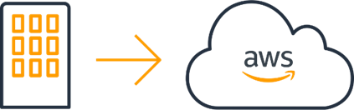

AWS as DR site for an on-premises workload
With CloudEndure
ASSESSMENT
SETUP
OPERATION
RECOVERY
Blueprint corrections needed?
Map Environment
Identify servers and networking, define recovery objectives
Install Agents Replication begins into lightweight Staging Area
Configure Blueprint
Instance type, subnet, security groups, etc
Test Target Servers Perform infrastructure and application acceptance tests
Maintain DR Readiness
Ongoing monitoring, periodic tests, add servers
Failover
Launch servers on AWS and redirect users
RPO: Sub-Seconds RTO: Minutes
Failback
Reverse replication and redirect users
Notes:
CloudEndure Disaster Recovery, available from the AWS Marketplace, continuously replicates serverhosted applications and server-hosted databases from any source into AWS using block-level replication of the underlying server. CloudEndure Disaster Recovery enables you to use AWS Cloud as a disaster recovery Region for an on-premises workload and its environment. It can also be used for disaster recovery of AWS hosted workloads if they consist only of applications and databases hosted on EC2 (i.e. not RDS). CloudEndure Disaster Recovery uses the Pilot Light strategy, maintaining a copy of data and switched-off resources in an Amazon Virtual Private Cloud (Amazon VPC) used as a staging area.
These are the steps to consider for CloudEndure
Assessment – paper exercise to identify servers and networking to be mapped over to the staging environment and defining the recovery objectives
Install agents – Currently cloudendure can only replicate Windows and Linux based servers
Blueprint: Blueprint defines your AWS environment and replication frequency
Test servers: Once you have implemented your staging environment, you can test it without impacting your production environment
If need be, adjust the blueprint based on your testing learnings
Lastly, implement ongoing monitoring to ensure DR readiness
IN the event of a DR, cloudendure will handle automatic failover and upscale your environment for you

Slide 13












How CloudEndure Disaster Recovery works
CloudEndure Agent Handshake
APIs to create Staging Area and launch target machines
CloudEndure
User Console
Replication server configuration and ongoing monitoring
Corporate data center / any cloud
Target Region
Staging Area subnet
Target subnet
Continuous, block-level data replication traffic (compressed
& encrypted) with
RPO of seconds
CloudEndure Agent
Launched target EC2 instance
Staging Area replication servers
(Lightweight Linux EC2 instances)
Automated orchestration and machine conversion enable RTO of minutes regardless of disk size
CloudEndure Agent
Launched target EC2 instance
Disks
Staging EBS Volumes
Target EBS volumes
Continuously replicates any application or database from any source into AWS
Business outcome: Use AWS to significantly reduce DR TCO while improving recovery objectives
Notes:
This high-level architecture diagram illustrates how CloudEndure Disaster Recovery keeps your entire environment in sync and ready to failover to AWS at any time, with aggressive recovery objectives and significantly reduced TCO.
On the left is the source environment, which can be composed of different types of applications – in this case, we give Oracle databases and SQL Servers as examples.
The CloudEndure Agent is deployed on the source machines without requiring any kind of reboot and without impacting performance in any noticeable way. That initiates continuous data replication of that data into AWS, and CloudEndure provisions a very low-cost staging area that helps reduce the cost of cloud infrastructure during replication, and until that machine actually needs to be spun up during failover or DR tests.
When that time arrives, with the click of a button, CloudEndure launches the machines in the appropriate target subnets of your choice. The dormant lightweight state, called the Staging Area, is now launched into the actual servers that have been migrated from the source environment (the Oracle databases and SQL Servers).
CloudEndure’s machine conversion technology ensures that those replicated machines can run natively within AWS, and the process typically takes just minutes for the machines to boot, regardless of the source.

Slide 14
Disaster Recovery options in AWS
Warm standby in AWS
Hot standby
(with multi-site)
Backup & Restore
Pilot light
Low
High
RPO/RTO: Hours
RPO/RTO: Tens of Minutes
RPO/RTO: Minutes
RPO/RTO: Real-time
Test/Dev Environments
Solutions: Amazon S3, AWS Storage Gateway
Cost: $
Production workloads
Scale AWS resources in response to a DR event
Cost: $$
Business critical workloads
Core services
Cost: $$$
Mission critical workloads
Active/Active modes using at least two AWS regions
Cost: $$$$

Slide 15
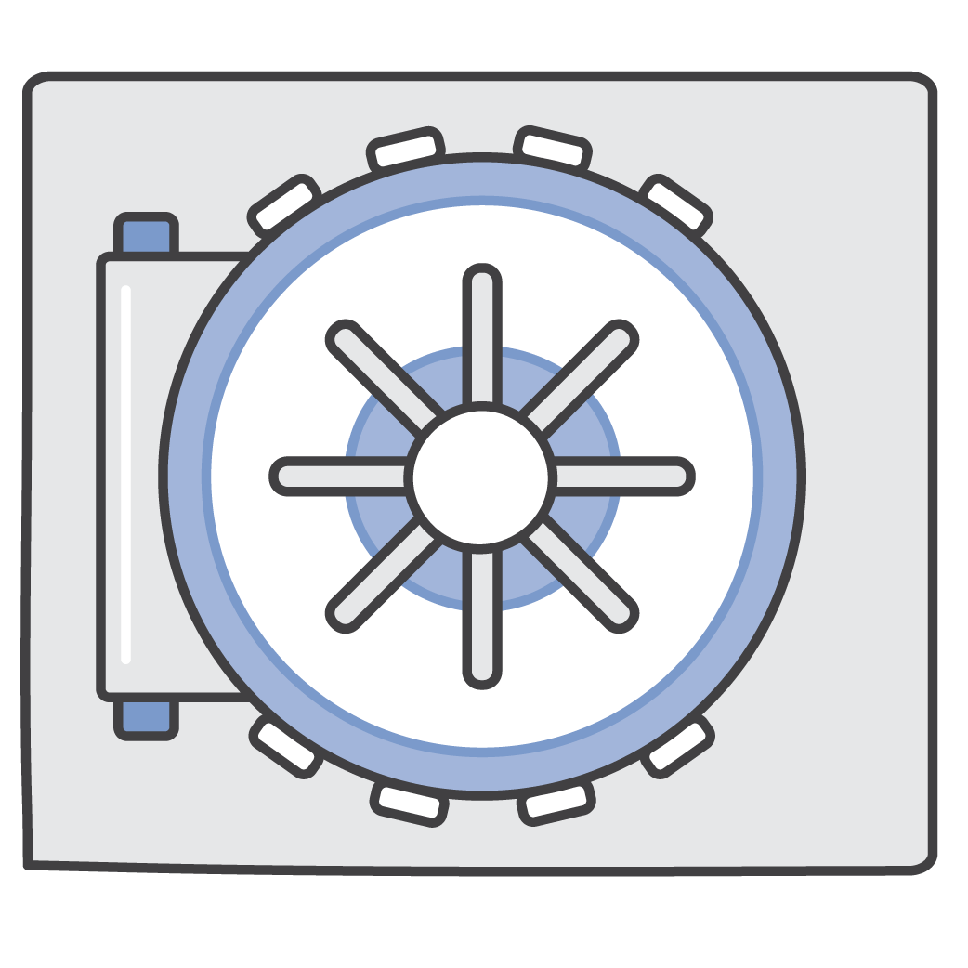
Backup & Restore
Suitable for:
Services that can sustain longer recovery times
Lower priority use cases
Point-in-time copy of data (user, configuration, and code)
Infrastructure restored with backed up data
Leverage existing backup infrastructure
Notes:
RPO: <24 hours; RTO: 24 hours.
Let’s look at backup and recovery. This is a simple and a low-cost DR approach that backs up your data and your applications code and configuration from anywhere to the AWS cloud and it allows you to use it for recovery from any event. With backup and recovery you can assume an RPO and an RTO of let's say less than 24 hours. The RTO and RPO is influenced by your backup intervals. So its good for those less important applications that don't have a high business continuity need.
Backups are point-in-time copy of your data to prevent logical errors such as system failure, application error, or accidental deletions. Backups can be run on-premisses to the cloud, either directly to a cloud target or via a gateway appliances, or enable backup in AWS services within the cloud. Given that you can directly or through a gateway appliance backup on prem data to AWS means you can leverage existing backup infrastructure
Some examples of AWS Services enabling this scenario are Amazon S3 to store your data, AWS Backup to schedule backups, and AWS Cloudformation to define your resources as code and deploy when needed .

Slide 16




Storage Gateway Family
Amazon S3 File Gateway
Amazon FSx File Gateway
Tape Gateway
Volume Gateway
Native file access to Amazon S3 for backups, archives, and ingest for data lakes
Native access to Amazon FSx for on-premises group file shares and home directories
Replace physical tape infrastructure leveraging Amazon S3 archive tiers for long-term retention
Block storage volumes with EBS snapshots, AWS Backup integration, and cloud recovery
Notes:
Backup leverages the AWS Storage Gateway Family
Storage gateway family is a set of hybrid cloud services that gives you on-premises access to virtually unlimited cloud storage. Customers use Storage Gateway to integrate AWS Cloud storage with existing on-site workloads so they can simplify storage management and reduce costs for key hybrid cloud storage use cases. These include moving backups to the cloud, using on-premises file shares backed by cloud storage, and providing low latency access to data in AWS for on-premises applications. To support these use cases, Storage Gateway offers four different types of gateways – Amazon S3 File Gateway, Amazon FSx File Gateway, Tape Gateway, and Volume Gateway – that seamlessly connect on-premises applications with cloud storage.

Slide 17
Thank you!
© 2020, Amazon Web Services, Inc. or its Affiliates. All rights reserved. Amazon Confidential

Slide 18
Appendix

Slide 19







Multi-AZ for high availability (HA)
Availability Zone A
Availability Zone B
Availability Zone C
VPC
Amazon Simple Storage Service (S3)
NAT gateway
Elastic Load Balancing
NAT gateway
NAT gateway
Amazon DynamoDB
Auto Scaling group
Instance
Instance
Instance
Amazon Relational Database Service (Amazon RDS) (primary)
Amazon RDS (standby)
Amazon RDS read replica
Notes:
Let’s highlight the difference between HA and DR by walking through this example.
This is an example of a simple 3-tier architecture, making use of three availability zones
The ELB is a Managed Service
EC2 instances are in all 3 AZs
The RDS is also in multiple AZs
S3 and DynamoDB: These services automatically replicate data and compute across multiple Azs – regional (versus zonal)
=====================================
RDS you simply tell it to be multi-AZ
S3 is our durable, highly available, and infinitely scalable object store
DynamoDB is our fast and flexible nonrelational database service for any scale.
S3: designed to provide 99.999999999% durability of objects over a given year… redundantly store your objects on multiple devices across a minimum of three Availability Zones (AZs) in an Amazon S3 Region
https://aws.amazon.com/s3/faqs/
DynamoDB: All of your data is stored on solid-state disks (SSDs) and is automatically replicated across multiple Availability Zones in an AWS Region, providing built-in high availability and data durability
https://docs.aws.amazon.com/amazondynamodb/latest/developerguide/Introduction.html

Slide 20



Multi-site (Normal mode) www.example.com
AWS Cloud
Active
Elastic load
balancing
Corporate data center
Active
Route 53
Reverse proxy/ caching server
Application data source cut over
Application server
Secondary
Primary
Mirroring/replication
Database server
AWS Region
Notes:
You can run your workload simultaneously in multiple Regions as part of a hot standby active/passive strategy
hot standby serves traffic only from a single region, and the other Region(s) are only used for disaster recovery
Hot standby uses an active/passive configuration where users are only directed to a single region and DR regions do not take traffic
When a disaster occurs failover to the DR region is automatic
Amazon Route 53 is a highly available and scalable cloud Domain Name System (DNS) web service. Amazon Route 53 effectively connects user requests to infrastructure running in AWS – such as Amazon EC2 instances, Elastic Load Balancing load balancers, or Amazon S3 buckets – and can also be used to route users to infrastructure outside of AWS. You can use Amazon Route 53 to configure DNS health checks, then continuously monitor your applications’ ability to recover from failures and control application recovery with Route 53 Application Recovery Controller.

Slide 21


Warm standby (Normal mode) www.example.com
AWS Cloud
Users
Scaled down
standby
Corporate data center
Active
Inactive
Reverse proxy/ caching server
Route 53
Application server
Primary
Secondary
Mirroring/replication
Database server
AWS Region
Notes:
DB mirroring and replication
Other compute resources have been created but are shutdown.
In the case of an event, those would have to started and you would have to wait for them to come online

Slide 22
Warm standby (DR mode) www.example.com
AWS Cloud
Users
DR at full scale
Scaled down
standby
Corporate data center
Active
Inactive
Active
Reverse proxy/ caching server
Route 53
Application server
Primary
Primary
Secondary
Database server

Slide 23
Pilot light prep www.example.com
Corporate data center
AWS Cloud
Reverse proxy/ web server
Define DR environment using Infrastructure as code
No compute provisioned for web/app tier in DR environment
Application server
Data mirroring replication
Primary
Secondary
Pilot light system
Database server
Database server

Slide 24

Pilot light prep www.example.com
Corporate data center
AWS Cloud
Reverse proxy/ web server
Reverse proxy/ web server
Achieve significant savings with DR costs
Application server
Application server
Data mirroring replication
Primary
Primary
Secondary
Pilot light system
Database server
Database server

Slide 25
Immediate Cloud Backup Benefits
Leverage existing investments in infrastructure
…cloud as a backup target integrates with existing backup frameworks
Cost effective offsite storage alternatives
…with pay as you go pricing and no upfront capital investments
Elimination of physical tape backups and administration
…for a low-cost, highly scalable virtual alternative with nominal disruptions to existing systems
Unlocking insights from your data
…by applying analytics, artificial intelligence, and machine learning capabilities
Notes:
With that capability, we start to feel immediate benefits by backing up into the cloud
these include…
The ability to leverage existing investments. All major backup vendors support Amazon S3 as a storage target, enabling customers to leverage the benefits of the cloud with minimal modifications to existing workflows. This is one of the reasons that backups are one of the first workloads that customers migrate to the cloud.
You get the benefits of a cost effective offsite storage platform, providing physical separation from your on premises primary data, with pay as you go economics, and no upfront fees or capital investments, and near zero overhead to manage.
If you are backing up to tape, we can help you eliminate that infrastructure, complexity and expense, including the cost and overhead associated with 3rd party tape vaulting services.
And if you are storing your backup data in the AWS cloud you have the ability to repurpose that data for performing analytics, or providing copies to test/dev teams that can spin up resources on demand to run tests or develop products

Slide 26




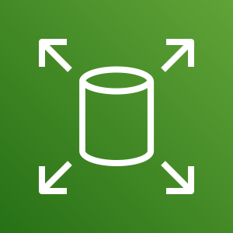
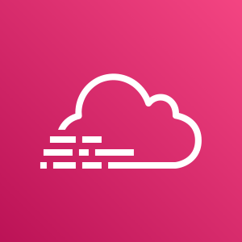




AWS Storage Gateway On-premises access to virtually unlimited cloud storage
On-premises
AWS Cloud
Storage Services
Security, Management & Monitoring
App/DB
Server
Storage Gateway
Standard Protocols
HTTPS
User Workstation
Optimized uploads
Storage Gateway Managed Service
Local cache for low latency access
Media
Server
Deployment options: VMware, Hyper-V, KVM, Amazon EC2, Hardware appliance
AWS Direct Connect/VPN
Notes:
AWS Storage Gateway is a hybrid cloud storage solution that helps customers take advantage of the scale and efficiencies the cloud provides and bridge the gap between their on-premises environments and the cloud. Storage Gateway enables on-premises applications to use cloud storage by providing low-latency data access over standard storage protocols. You don’t need to make any changes to your existing backup tools and can use the same technology and processes to back your data to the cloud.
Specifically:
Storage Gateway allows customers to connect to and use key cloud storage services such as Amazon Simple Storage Service (S3), Amazon S3 Glacier, and Amazon Elastic Block Store (EBS).
Storage Gateway easily deploys on-premises, as a virtual machine (we support all the major hypervisors) or via a pre-configured hardware appliance.
By providing a local cache, Storage Gateway enables low latency access to frequently accessed data.
Storage Gateway supports access via standard storage protocols (NFS, SMB, iSCSI, and iSCSI VTL) for on-prem applications to access data stored in Amazon S3. So no changes to customers’ applications.
Data is transferred securely and efficiently between the on-premises environment and AWS.

